Slide 1

Bayesian Neural Network Classification of EEG Correlates of Memory
Team DeepEEG:
David DiStefano (knowledge of dataset)
Saber Bahranifard (algorithms)
Rohan Deshpande (programming)

Slide 2
Project Motivation
Accurate Classification of “Brain States” using EEG Data
Area of Interest in Brain-Computer-Interface Research
Particularly, classification of states of memory
Can we identify “good” or “poor” brain states for memory encoding?
Support Vector Machine classification of spectral EEG data has yielded relatively poor classification accuracy (~60%)
How well might the deep learning approach of the Bayesian Neural Network apply to binary classification of EEG data?
Notes:
Trying to connect state of brain to the encoding of visual stimuli into memory
Data from 7 participants
Spectral Power across 12 scalp regions
7 frequency bands (1Hz to 42Hz)
4 time windows of 500ms
Evaluate BNN performance as hidden layers are added, and against SVM performance

Slide 3
Task Formulation
Inputs
EEG Data
Collected from 7 participants
Individually trained models for each participant
~250 trials per participant
336 features per trial
spectral power values across:
12 scalp regions
7 frequency bands
4 time windows
Outputs
Each trial is labeled with a 1 or a 0, representing a “hit” or a “miss”, respectively
Hit: Participant remembered the visual stimulus
Miss: Participant did not remember the visual stimulus
BNN outputs a predicted label, 1 or 0, corresponding to a “hit” or “miss” prediction

Slide 4
Research Question / Hypothesis
Hypothesis: A probabilistic model like a BNN w/ VI will perform better on a classification task than a non-probabilistic model like SVM with a linear kernel
Performance Metrics
Classification Accuracy
Sensitivity (True Positive Rate)
Specificity (True Negative Rate)
The model should perform better because:
Avoids overfitting on the data
Does not require a linear decision boundary

Slide 5
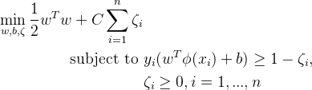

Baseline Method
Support Vector Machine (SVM)
Soft constraint SVM for classification:
where C is the regularization parameter swept to find the best performance
Dual representation:
Linear kernel, K, is used because the number of features is more than the number of data samples
Using sklearn library
Pros: can handle large set of input features because of using kernel
Cons: the model is non-probabilistic therefore lacks an expression of prediction uncertainty
Notes:
For the sake of this project we try to compare a probabilistic and a non-probabilistic model. The non-probabilistic model is a soft constraint SVM which is governed by a regularization hyperparameter. Although lack of introducing uncertainty in the model could result in poor performance in capturing the uncertainty in the data, this model takes the advantage of Kernel functions to handle large set of input features.
In this project, we use built-in functions of sklearn library to implement a SVM classifier. Since the number of features is more than the number of data samples, a linear Kernel is used. Also, we use cross validation method along with grid search to find the optimal value for the regularization parameter.

Slide 6



Proposed Method
Binary Classification using a Bayesian Neural Network
Single Hidden Layer BNN for binary classification
Build a probabilistic model on top of a NN to put uncertainty over network parameters, with following properties:
Prior over network weights:
Bernoulli Likelihood:
Target posterior (intractable):
Features of Input
Input
Layer
Hidden Layer
Output Layer
Probabilistic Output
x_0
y
x_1
Sigmoid function applied to output layer
Scales network output to [0,1] probability range
Prediction = Hit: if y>=0.5 Miss: if y<0.5
y = targets
x = training data
w = weights
b = biases
Notes:
To introduce uncertainty into the model we use a Bayesian approach to build a probabilistic model on top of the parameters of a Neural Network. For this purpose, a simple Normal distribution prior with mean zero and variance one is defined over network weights and biases. Because the model is supposed to be a binomial classifier, a Bernoulli Likelihood is defined over output given the input data and network parameters.
A single hidden layer NN with 5 hidden units is used which its output layer uses a sigmoid function as activation function. The resulting posterior over the network parameters given data and labels is intractable and we can’t find a closed form for it because of the nonlinearities introduced by activation functions of the network.

Slide 7


Proposed Method (cont.)
Binary Classification using a Bayesian Neural Network
Variational Inference (VI) to approximate posterior
Variational distribution, q:
Objective function is the Evidence Lower Bound (ELBO)
Analytical solutions of expectations w.r.t approximate posterior is intractable, often
Reparameterization trick is used as SGVB estimator to find simple approximate posterior
MC sampling to calculate an unbiased estimator
Notes:
To be able to approximate the true posterior and use it for predictions, our proposed method uses Variational Inference approximation which is a stochastic approximation method. A simple variational distribution q over network parameters is defined. This variational posterior is normal distributions over network parameters with individual mean and variance per network parameter. ELBO function is used as objective function to be optimized with respect to VI posterior hyperparameters to make the variational posterior as similar to the true posterior as possible. Again, calculating solutions of expectations w.r.t. Approximate posterior is often intractable. Thus a reparametrization trick is used as a stochastic estimator to find approximate posterior. After implementing this trick, Monte Carlo sampling can be used as an unbiased estimator of the gradient of elbo.

Slide 8
Proposed Method (cont.)
Binary Classification using a Bayesian Neural Network
Hyperparameters:
# of layers, L:
start with 1 layer and increase L to see the effect on the outcome
# of units per layer, J:
we obtain results for 5, 10, 20, and 50 units per hidden layer and compare results
Learning rate, :
try to adapt different values for alpha from to to observe the change in results
# of MC samples:
50
Strengths: added uncertainty over NN parameters helps to prevent overfitting
Limitations: computationally expensive; many hyperparameters to tune
Notes:
Multiple hyperparameters need to be tuned under this approach. The most important ones that we are trying to tune are number of hidden layers, number of hidden units, learning rate, and number of MC samples.
This method introduces uncertainty into the model which avoids overfitting to the data. However, this is gained with the cost of huge computational overhead due to many hyperparameters tuning and slow sampling techniques.

Slide 9
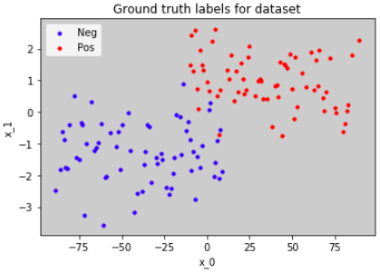
Experimental Results
Toy Data
Semi-randomly generated data
200 Trials, 2 features (x_0, x_1)
100 Hits (positives)
100 Misses (negatives)
Evaluation Protocol
K-fold cross-validation
K = 3
Equal ratio Hits/Misses in Train and Test sets
Train on 2/3 data (training fold)
Test on held-out 1/3 data (validation fold)
Average fold performance metrics
Validation Fold
Training Fold
Performance
Fold 0
Fold 1
Fold 2
Performance
Mean Performance Metrics
Performance

Slide 10
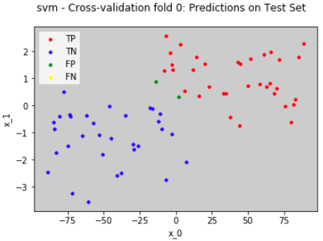

Experimental Results (cont.)
Example predictions on test set
SVM BNN

Slide 11
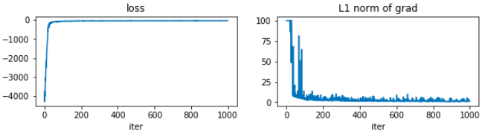
Experimental Results (cont.)
Mean loss and L1 norm of grad across CV folds
Baseline vs Focus Method Performance Metrics
Metric Average over cross validation folds | SVM | BNN
Mean class acc | 97.00% | 95.92%
Mean sensitivity | 95.96% | 97.21%
Mean specificity | 98.04% | 94.63%

Slide 12
Future Work
Debug BNN approach for EEG dataset
Preliminary results prove difficulty with 336 features
Simple logistic regression shows classification should be possible
Comparison between models with differing numbers of layers
Hypothesis: Test accuracy should increase as the number of layers increases, before plateauing and decreasing as overfitting occurs
Observe training and test accuracies over VI iterations and network depth

Slide 13
Take Home Lessons
Deep Learning is not a “magic bullet”
Requires a lot of overhead
Not guaranteed to outperform non-deep ML methods
Need to ensure that BDL methods are appropriate
EEG Data may have too many features to use without significant preprocessing
Original trials had 25,000 features each
Reduced to 1,000 and then to 336
Smart feature extraction and preprocessing is needed

Slide 14
Thank You!
Features of Input
Input
Layer
Hidden Layer
Output Layer
Probabilistic Output
Good
Memory!
x_0
y
x_1

Slide 15
Single Hidden Layer BNN for binary classification
Features of Input
Input
Layer
Hidden Layer
Output Layer
x_0
Sigmoidal Output
y
x_1

Slide 16
Experimental Results - keep this slide for reference
Results on any one dataset (small/toy or large)
Dataset and eval. protocol (esp. train/test) clear and appropriate
Performance metrics are clear and appropriate
Focus and baseline methods compared with critical interpretation
Answer provided to the research question/hypothesis

